Slide 1
Memory Management in Pentium

Slide 2
Outline
Pentium General Memory Management
Pentium Paging
Segmentation
Pentium Segmentation

Slide 3
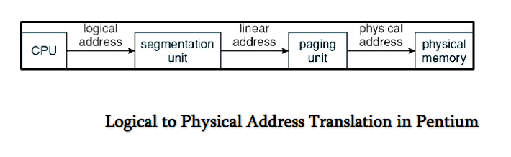

Slide 4
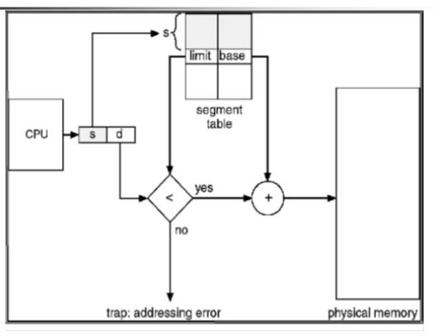
Segmentation

Slide 5
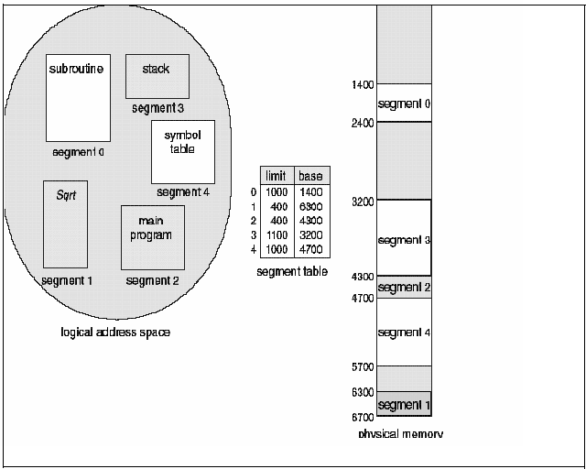
Segmentation

Slide 6
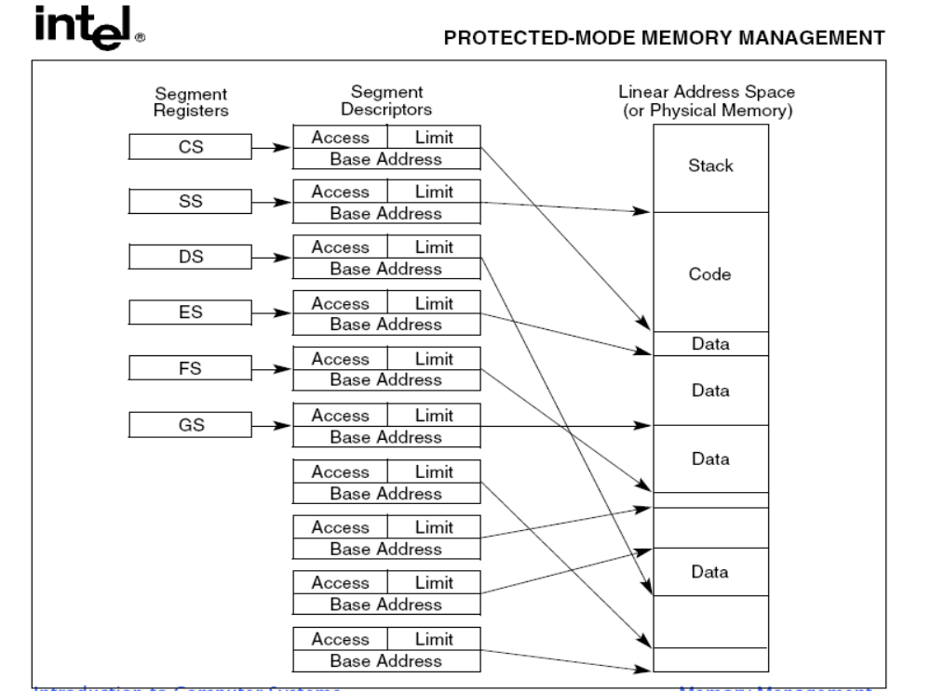
Pentium Segmentation I

Slide 7
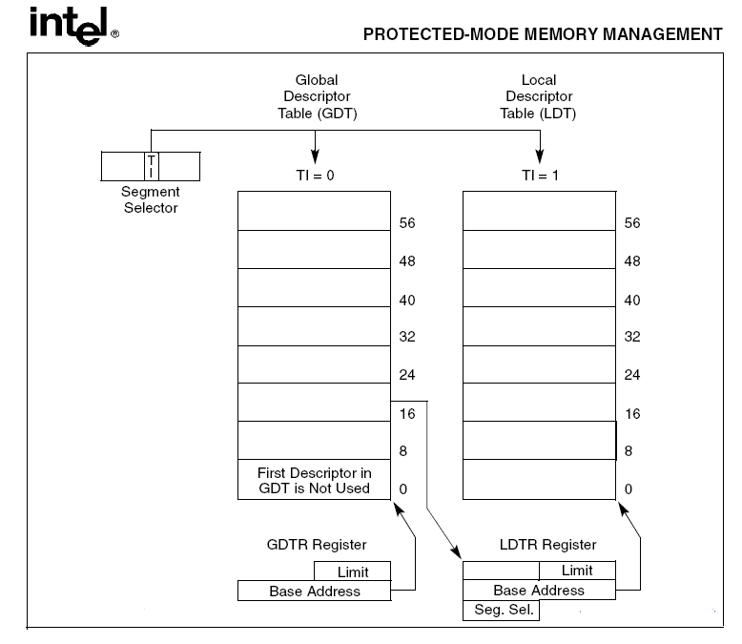
Pentium Segmentation

Slide 8
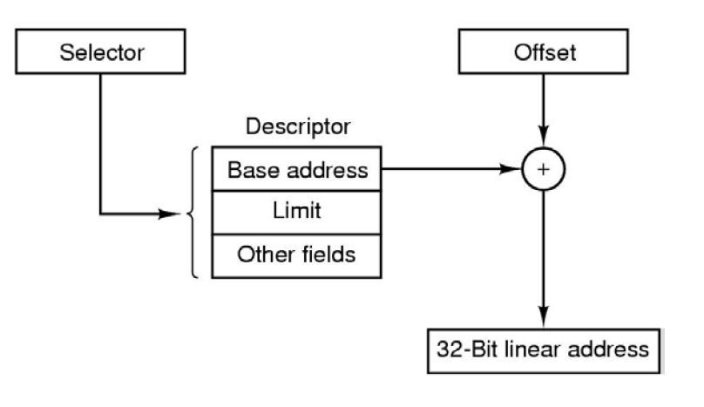

Slide 9
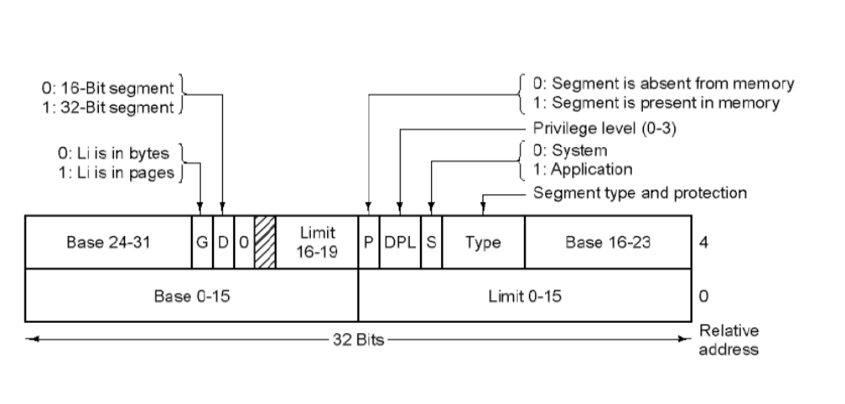

Slide 10
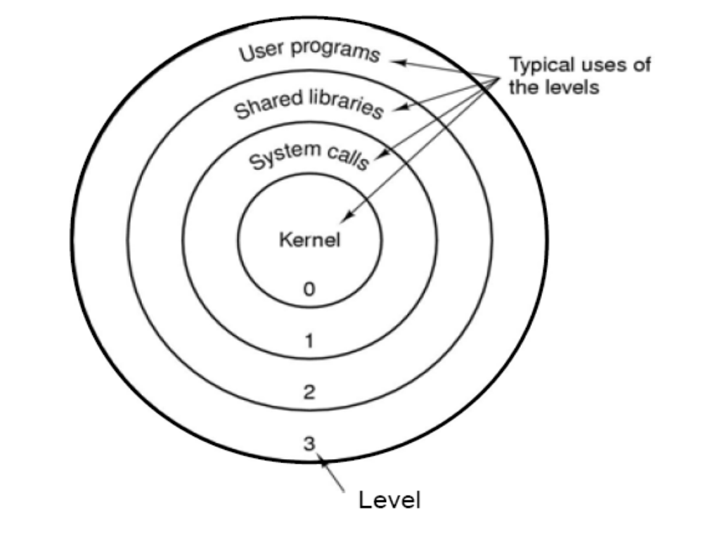
Protection Levels in Pentium
13
1
2
(16 bit Selector)
Protection Bits

Slide 11
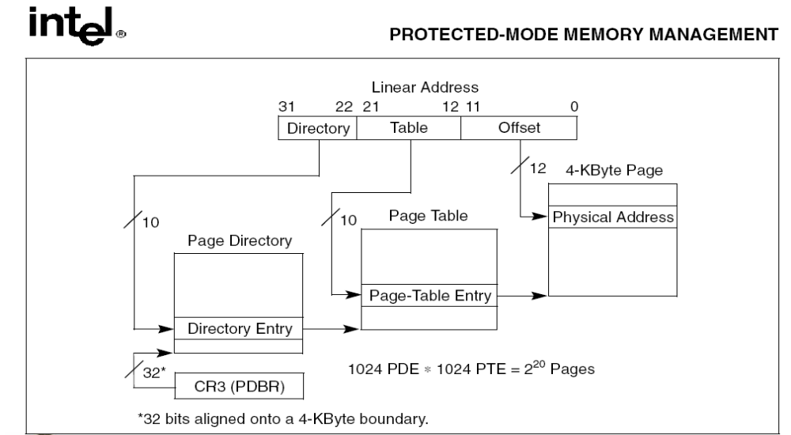
Pentium Paging
Pages can be of 4 MB each. Directory entry directly point to a Page in this case.

Slide 12
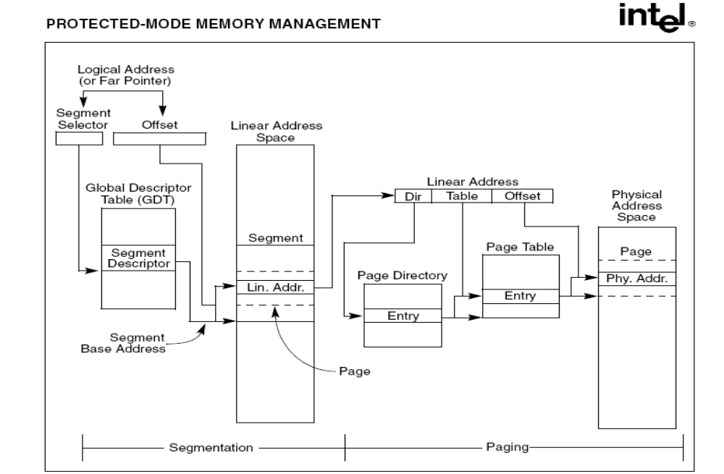
Pentium General Memory Management
Each segment can grow dynamically, so segments have to be paged

Slide 13
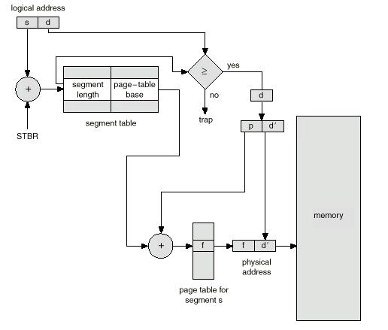
Segmentation with Paging: Another example
Differs from pure segmentation in that the segment-table entry
contains not the base address of the segment, but rather the base address of a page table for this segment

